Slide 1

CS 2450 – Advanced Programming
Chapter 7: Using a Database

Slide 2
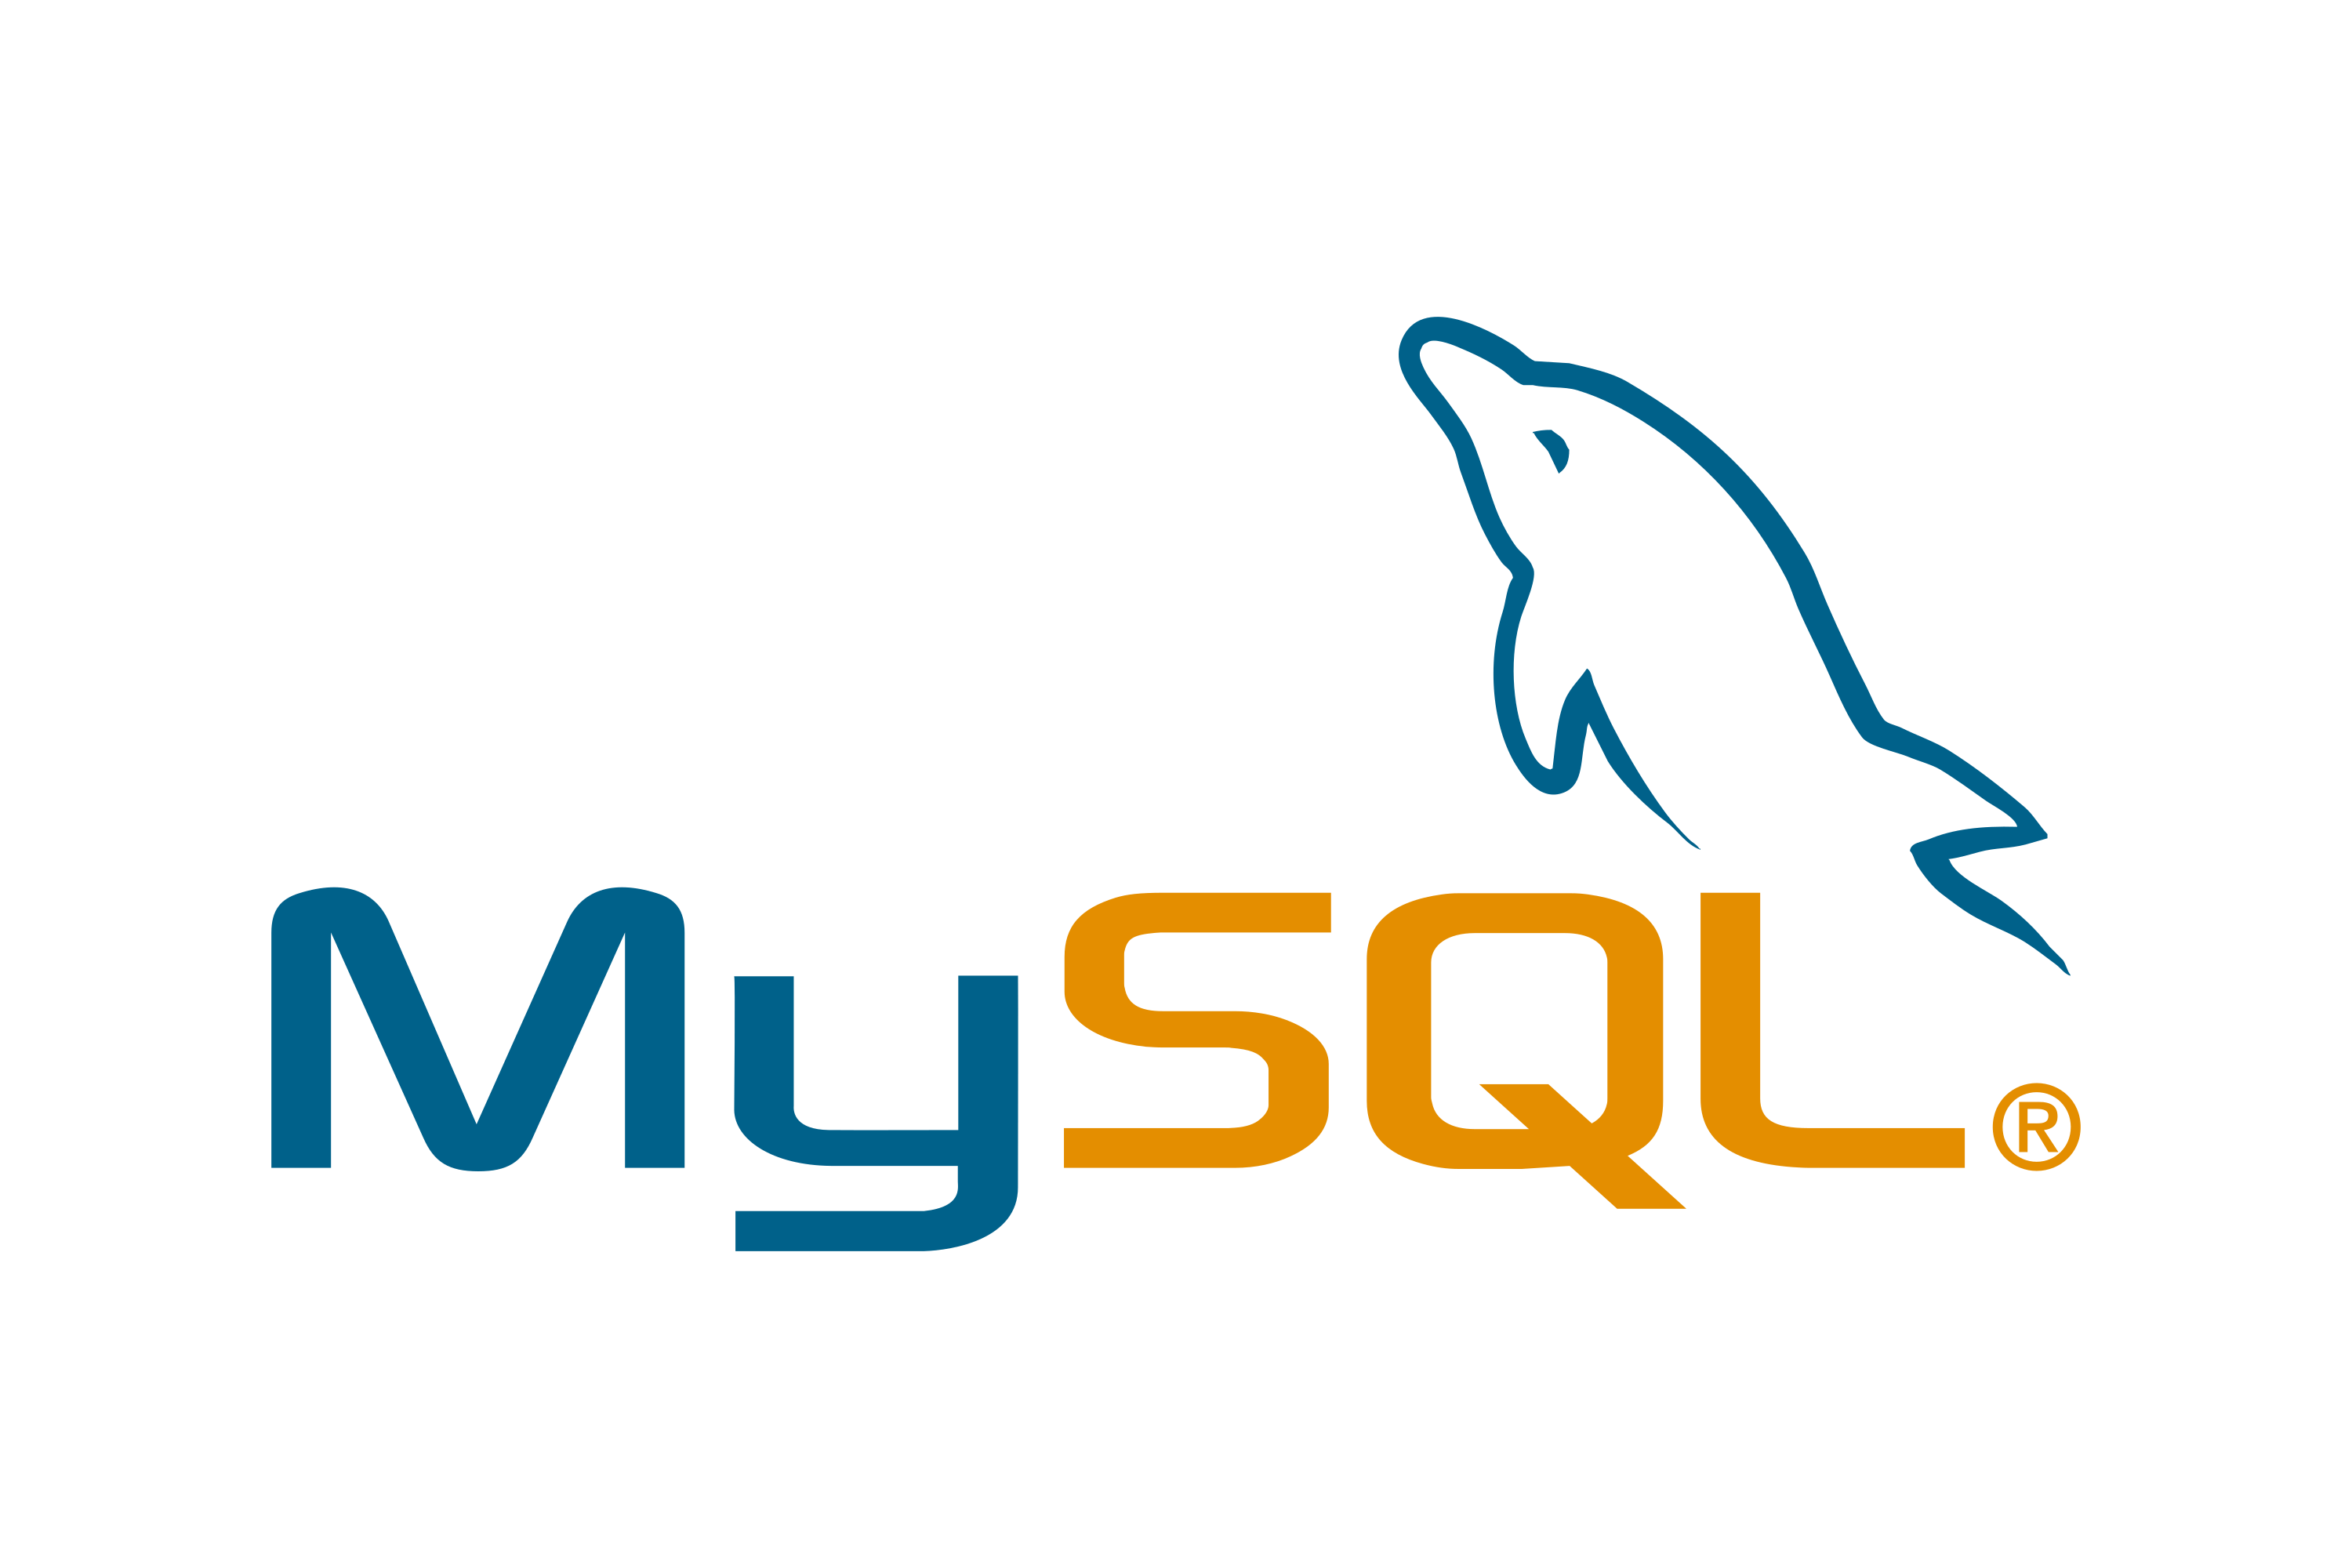
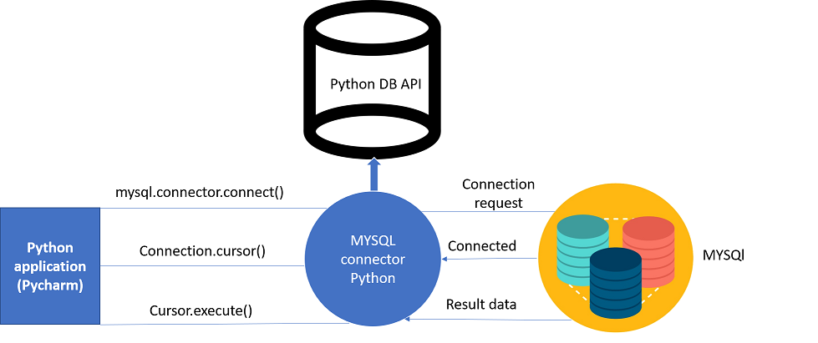
Storing Data in a Relational Database
In this chapter, you’ll learn how to write code that interacts with the popular MySQL database technology, using a generic database API called DB-API.
The DB-API (which comes standard with every Python install) allows you to write code that is easily transferred from one database product to the next...assuming your database talks SQL.

Slide 3
Storing Data in a Relational Database
In this chapter, you’ll learn how to write code that interacts with the popular MySQL database technology, using a generic database API called DB-API.
The DB-API (which comes standard with every Python install) allows you to write code that is easily transferred from one database product to the next...assuming your database talks SQL.

Slide 4
Installation of MySQL and Python Drivers
Install the MySQL server
Install a MySQL database driver for Python
Create our webapp’s database and tables
Create code to work with our webapp’s database and tables

Slide 5
Task 3: Create the Database and Tasks

